Slide 1

Chapter 1
Anthropology and The Study of Culture
Notes:
For a better classroom presentation flow, the order of some topics in this lecture outline differs slightly from the order of topics in the text and, where this occurs, some figures and tables are out of numerical order.

Slide 2
Learning Objectives
  1.1 Define what is anthropology.
  1.2 Recognize what is cultural anthropology.
  1.3 Summarize the distinctive features of cultural anthropology.

Slide 3
Anthropology and the Study of Culture
What is anthropology?
  The study of humanity, including its prehistoric origins and contemporary human diversity

Slide 4
Introducing Anthropology’s Four Fields
1.1 Define what is anthropology.
Vast scope, so “four fields” are needed to cover it all
  Biological or physical anthropology
  Archaeology or prehistory
  Linguistic anthropology
  Cultural anthropology
  Applied anthropology, a possible fifth field?

Slide 5
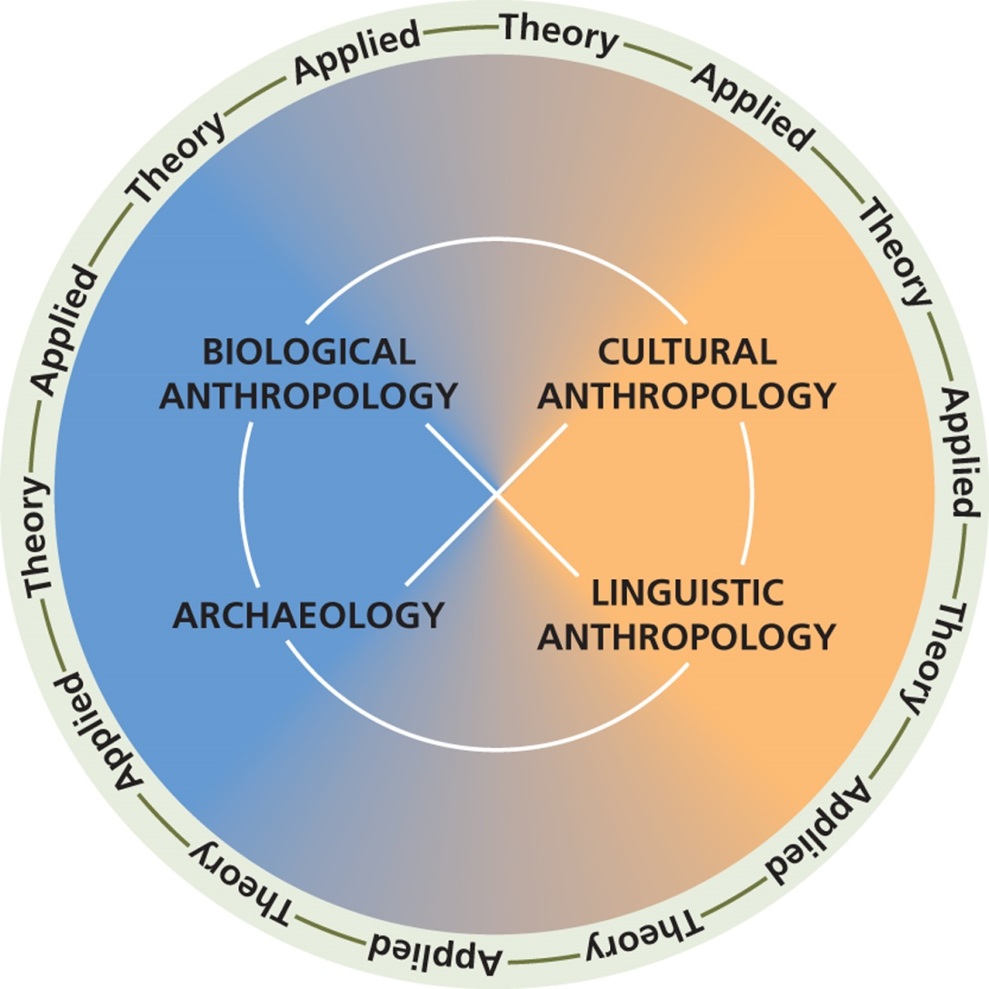
Figure 1.1 The Four Fields of Anthropology

Slide 6
Biological or Physical Anthropology
The study of humans as biological organisms, including their evolution and contemporary variation
  Human evolution (paleoanthropology)
  Nonhuman primates (primatology)
  Contemporary human variation

Slide 7
Archaeology
The study of past human cultures through their material remains
  Two major areas
    Prehistoric
    Historical
  Specialties based on context
    Underwater archaeology
    Industrial archaeology
Archaeology of contemporary life
    The “Garbage Project”

Slide 8
Linguistic Anthropology
Study of communication, mainly (but not exclusively) among humans
  Three major areas
    Historical linguistics
    Descriptive (or structural) linguistics
    Sociolinguistics
  Trends
    Discourse
    Role of information technology
    Rapid loss of indigenous languages

Slide 9
Cultural Anthropology
Study of the lifeways of the world’s living people, for example:
  Making a living
  Reproduction and life cycle
  Health
  Marriage and family
  Social groups, politics
  Language, art, religion . . . and MORE [the chapters in the text and class lectures cover all these “subfields”]

Slide 10
Applied Anthropology: Separate Field or Cross-Cutting Focus?
Applied Anthropology
  Involves the use or application of anthropological knowledge to help solve social problems
  A separate field? No . . .
    Just like theory, application should be a valued part of every field of anthropology

Slide 11
Anthropology Works:
Delivering Health Care in Rural Haiti
  The work of Paul Farmer includes:
    Publications
    Health-care delivery
    Advocacy as part of an NGO
  He argues that health problems can be understood as the products of poverty and social injustice

Slide 12
Introducing Cultural Anthropology (1 of 2)
1.2 Recognize what is cultural anthropology.
Highlights in the History of Cultural Anthropology
The Concept of Culture
Multiple Cultural Worlds
Three Theoretical Debates

Slide 13
Introducing Cultural Anthropology (2 of 2)
Behavior and Belief
  Two different emphases in anthropology concerning which is more important as constituting culture:
    Behavior:
      Cultural materialism
    Belief/thought:
      Cultural interpretivism

Slide 14
Highlights in the History of
Cultural Anthropology
The concept of evolution and functionalism
Franz Boas and cultural relativism
Margaret Mead and public anthropology
Claude Lévi-Strauss and French structuralism
Marxism and cultural materialism
The 1960s and interpretive anthropology
Postmodernism and structurism/agency

Slide 15
The Concept of Culture (1 of 6)
A simple definition of culture:
  Learned and shared ways of behaving and thinking

Slide 16
The Concept of Culture (2 of 6)
Two different emphases in anthropology concerning which is more important as constituting culture:
  Behavior: Cultural materialism
  Belief/thought: Cultural interpretivism

Slide 17
The Concept of Culture (3 of 6)
Characteristics of Culture
  Culture is not the same as nature
    Eating
    Drinking
    Sleeping
    Eliminating
  Culture is based on symbols
  Culture is learned
  Cultures are integrated
  Cultures interact and change

Slide 18
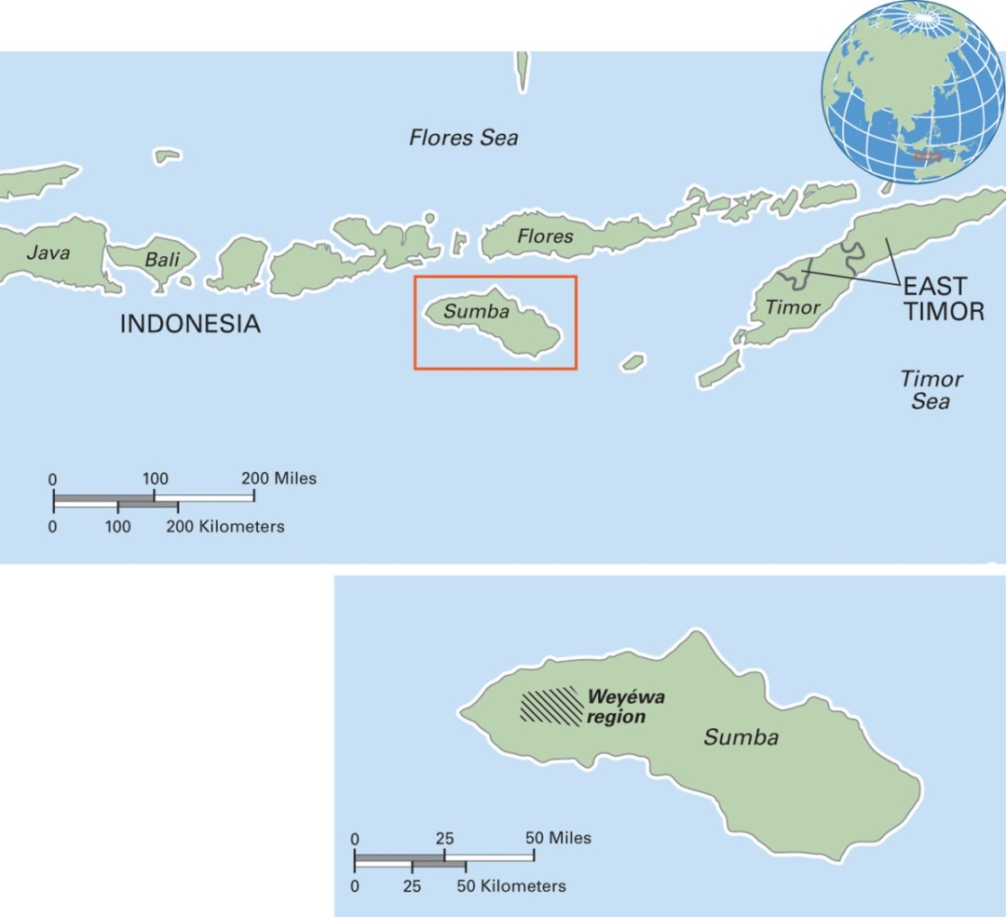
Map 1.1 Weyéwa Region in Indonesia
Culture is not the same as nature
  Among the Weyéwa, categories of taste differ from those of the West
Notes:
Sumba, one of Indonesia’s many islands, is 75 miles long. The Weyéwa people number about 85,000 and live in small settlements on grassy plateaus in the western part of the island. They grow rice, maize, and millet, and they raise water buffaloes and pigs.

Slide 19
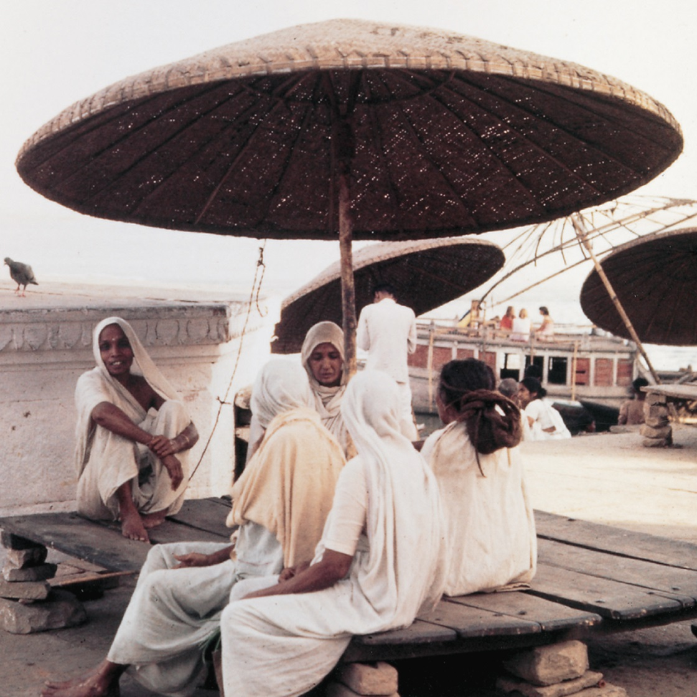
The Concept of Culture (4 of 6)
Culture is based on symbols
In India, widows wear white clothing to mark their status
Notes:
In India, a white sari (women’s garment) symbolizes widowhood.

Slide 20
The Concept of Culture (5 of 6)
Culture is learned
  Much cultural learning is absorbed unconsciously, through observation and practice
  Some is learned formally in schools
Cultures are integrated
  Example: highland Papua New Guinea

Slide 21
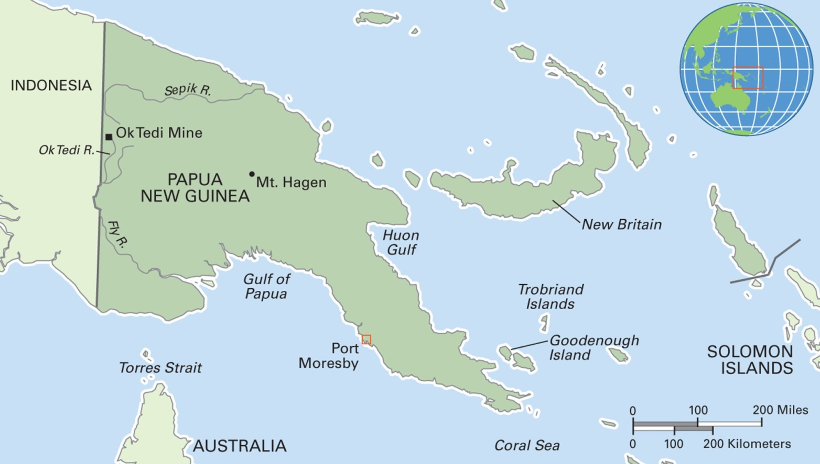
Map 1.2 Papua New Guinea
Notes:
The Independent State of Papua New Guinea (PNG), the eastern half of the island of New Guinea, gained its autonomy from Australia in 1975. Mostly mountainous with coastal lowlands, PNG is richly endowed with gold, copper, silver, natural gas, timber, oil, and fisheries. Its population is over seven million. Port Moresby, the capital, has a high rate of HIV/AIDS infection among the working-age population.

Slide 22
The Concept of Culture (6 of 6)
Cultures interact and change
  Figure 1.3 Four Models of Cultural Interaction
    Clash of civilizations, a conflict model
    Westernization, based on model from Western culture of takeover and homogenization
    Hybridization, a blending model
    Localization, a model in which a local remakes and transforms global culture

Slide 23
Multiple Cultural Worlds
Within large cultures, many microcultures exist
  A person may be a member of several microcultures
Figure 1.4 Some Bases of Microcultures:
  Class
  “Race”
  Ethnicity, indigeneity
  Gender, sexuality
  Age
  Institution

Slide 24
Three Debates in Cultural Anthropology
Biological Determinism versus Cultural Constructionism
Interpretive Anthropology versus Cultural Materialism
Individual Agency versus Structurism

Slide 25
Distinctive Features of Cultural Anthropology
1.3 Summarize the distinctive features of cultural anthropology.
Ethnocentrism and Cultural Relativism
Valuing and Sustaining Diversity
Cultural Anthropology Is Relevant to Careers

Slide 26
Ethnocentrism and Cultural Relativism (1 of 2)
Cultural anthropology has contributed two concepts:
  Ethnocentrism: Judging another culture by the standards of one’s own culture rather than by the standards of that particular culture
  Cultural relativism: The perspective that each culture must be understood in terms of the values and ideas of that culture and not judged by the standards of another culture

Slide 27
Ethnocentrism and Cultural Relativism (2 of 2)
Figure 1.5 Cultural Relativism: Two Views
  Absolute cultural relativism: Whatever goes on within a particular culture cannot be questioned or changed by outsiders, as that would be ethnocentric
  Critical cultural relativism: Anyone can pose questions about what goes on in various cultures, including their own culture, in terms of how particular practices or beliefs may harm certain members; follows Lévi-Strauss’s comment that no society is perfect and therefore all societies may be able to learn from others and improve

Slide 28
Valuing and Sustaining Diversity
Cultural anthropologists support the survival of indigenous peoples
The organization Cultural Survival helps indigenous peoples and ethnic minorities deal as equals in interactions with outsiders

Slide 29
Cultural Anthropology Is Relevant to Careers
Majoring in Anthropology
Graduate Study in Anthropology
Living an Anthropological Life

